Slide 1

Liquid Level Detection
Aaron Cochran​
Ian Brown
​Varun Vijaywargi​
Vamsidhar Reddy Bhavanam​
Group 1 Final
BUS ADM 745

Slide 2
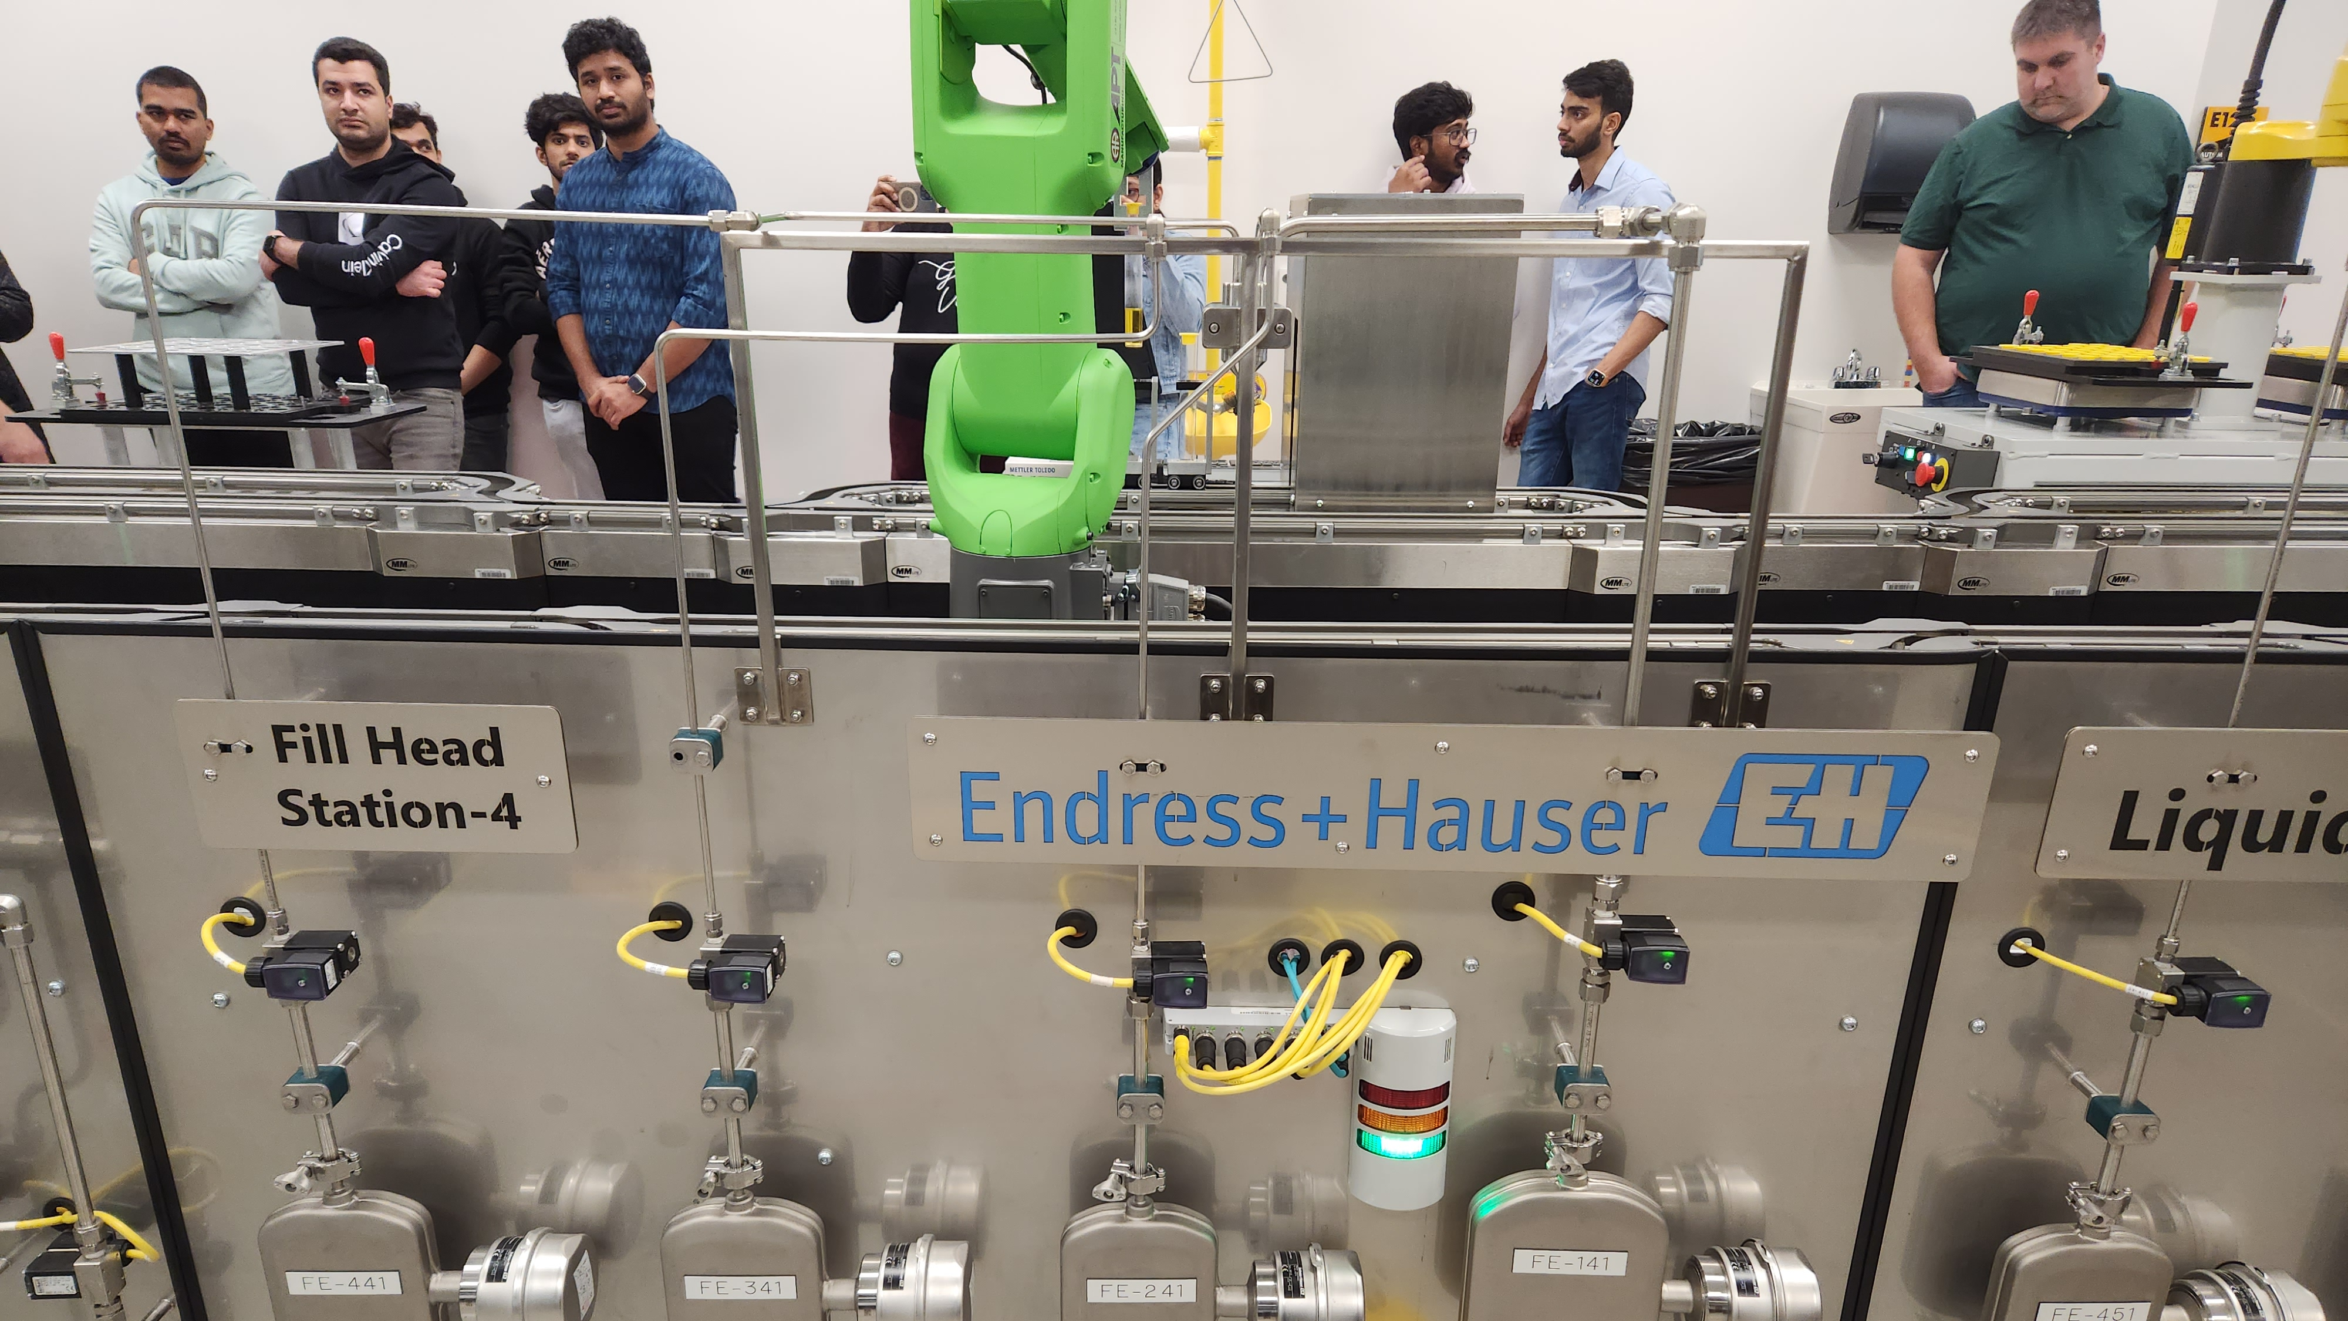
Introduction
Notes:
Read during presentation

Slide 3
Problem definition – workshop 1
From workshop 1 our focus is the wet fill process we propose a data-driven solution for optimizing product yield and reducing waste in manufacturing using logistic regression models.
Our solution involves leveraging historical data on product weight, color, and fluid dispensing ratios to train a logistic regression model that can predict the likelihood of a failed product being salvageable through rework.

Slide 4
Data for workshop 1
Read in the liquid fill data then isolate the failures.
We first read in the entire data set and then reduced it to isolate all the liquid filled records.
Then from that reduced data set we further reduced the outcome to include only failures.
From there we split the failures into fill station 3
A further reduction is to isolate the data that had weight failures.

Slide 5
Model for workshop 1
Separate the data that did not pass inspection and build the split and training test data set 80/20.
Fit logistic regression model.
Build a confusion matrix.

Slide 6
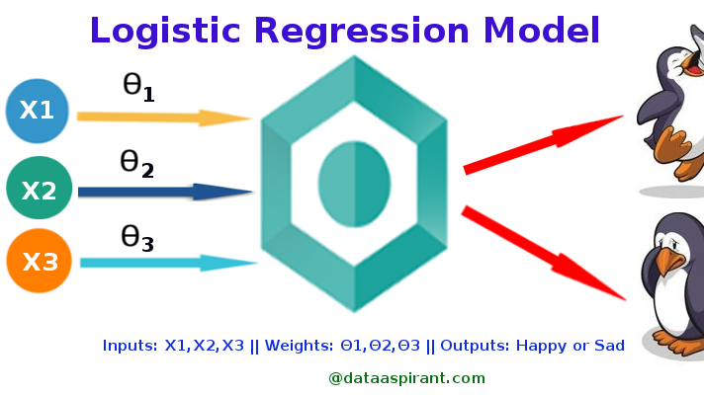
Logistic Regression

Slide 7
Confusion matrix for workshop 1
The Confusion matrix in this case shows that for our test set had 1 true positive and 2 true negatives, and 0 false negatives and false positives.
This means that the model correctly identified every vial that failed visual inspection. The absence of false negatives in this matrix indicates that the model did not miss any vials that failed visual inspection.

Slide 8
Summary and conclusions for workshop 1
The confusion matrix showed that the model correctly predicted the outcomes (no failure). An ROC curve showed that the model's performance was above chance, but it could be improved with a higher true positive rate at low false positive rates.
The results suggest that the model could benefit from additional variables or more sophisticated machine learning methods.
In conclusion, this logistic regression model provided a moderate level of accuracy in predicting the outcomes of visual inspections of liquid fill vials.

Slide 9
Problem definition – workshop 2
Following up workshop 1 we utilized computer vision AI (image data analysis) to verify and reinforce the predictive power of our original logistic regression models.
We chose to examine two different computer vision models one is a binary case (pass, fail) while the other is a tertiary case (under fill, correct level and overfilled).​

Slide 10
Data for workshop 2
Images from both recipe 1 vials and recipe 3 vials were used
Wrote code to sort images based on weight into overfill, under fill, and proper fill.
Weight data was flawed, we used visual inspect to manually classify images.
Cropped images to isolate just the vial and reduce background for the image classifier using photo. editing software to apply the cropping consistently across all images.

Slide 11
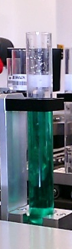
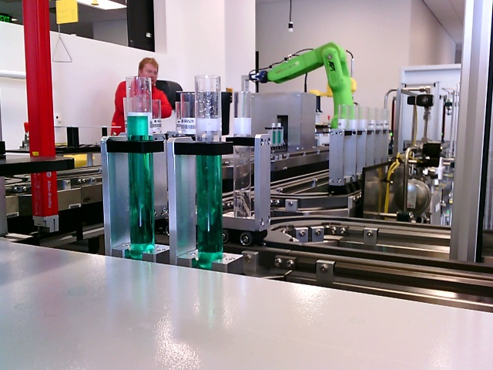
Images Cropped to Exclude Background

Slide 12

Model for workshop 2
Loaded images into Custom vision application.
Used small number of samples from the properly filled set so that training data would be balanced.
Cropped photos worked to help the model isolate relevant feature increasing accuracy from 75% to 100%.

Slide 13
Summary and conclusions for workshop 2
Model was able to correctly predict over-fill under-fill and proper-fill from test images.
Had some confusion with properly filled recipe 3 vials being classified as likely underfilled.
Larger training set would likely result in more precise classifications even when determining the ranges for how underfilled or overfilled the product is.
Has the ability to catch leaking or damaged containers even if they initially passed inspection.

Slide 14
Idealized Project
With more data project 1 could be improved to allow rework of a broader set of failed products.
Using the visual inspection RGB data, a classifier could be made to indicate what ingredient is missing or overfilled for vials that do not pass visual inspection.
Custom vision models from project 2 could also be improved to classify leaking or broken containers that might have passed inspection but are no longer properly filled so they don’t go out to customers.
The vision model could also be fine tuned to determine more precisely how much the vials are over/under filled.

Slide 15
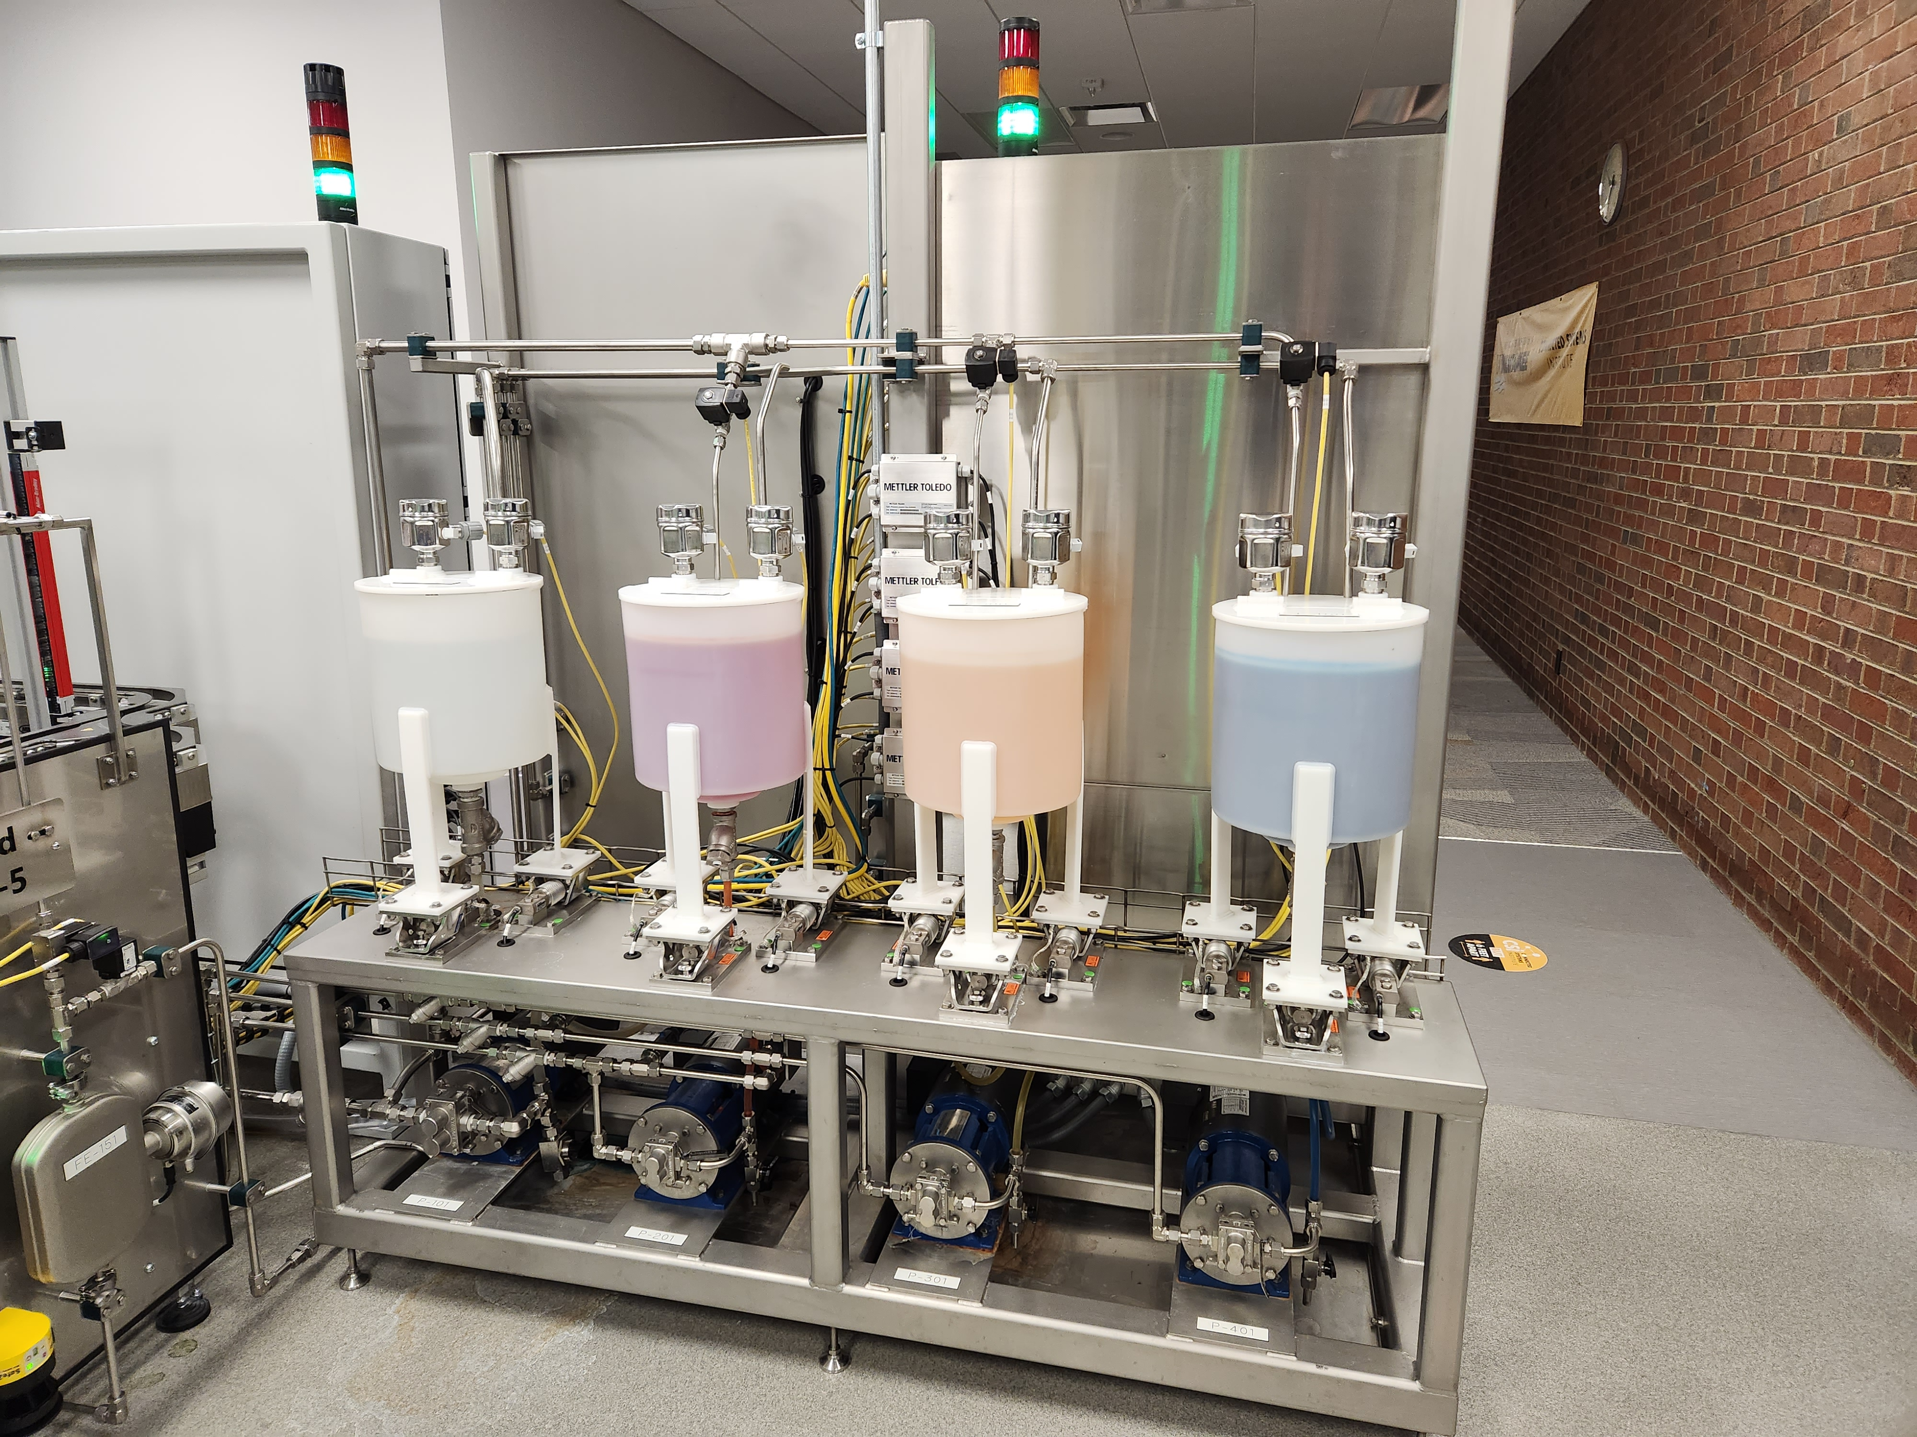


Slide 16
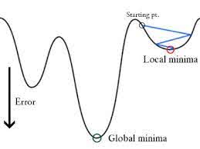
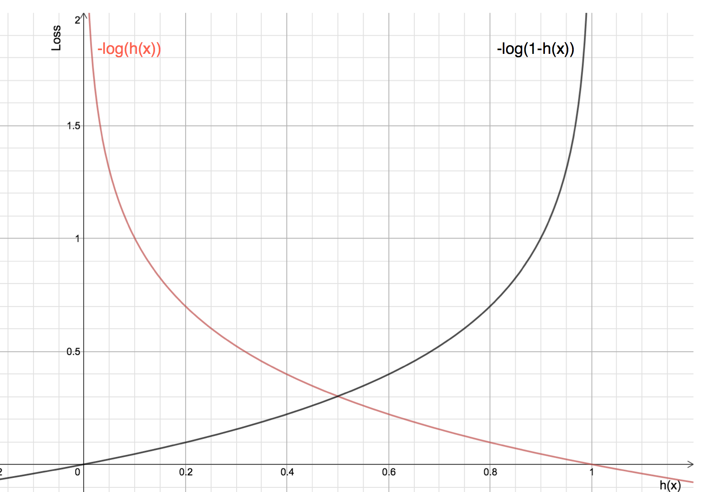
Cross Entropy cost function and Gradient Descent
Notes:
Not to be included in presentation

Slide 17
AI strategy
The specific business problem here is to reduce product waste and improve overall efficiency in an automated fill station environment.
Our AI solution will involve utilizing logistic regression algorithms and computer vision to detect the liquid level in real-time and automatically adjust the filling process to reduce product waste and improve efficiency.
Data on liquid level measurements and filling process parameters were collected and preprocessed to ensure accuracy and consistency.
The solution will need to be continuously monitored and optimized to ensure it is achieving the desired ROI by reducing product waste and improving overall efficiency.

Slide 18
Industrial environment perspective
Can help CSI stay competitive in an increasingly automated and data-driven industry
Improve safety
Increase efficiency
Enhance quality control
Enable predictive maintenance

Slide 19
Value creation perspective
The inclusion of AI has the potential to create significant value for CSI by:
Reducing product waste
Improving overall efficiency
Enhancing product quality
Enabling data-driven decision-making
Increase customer satisfaction by reducing amount of defective product shipped.

Slide 20
Organization and execution perspective
The implementation of AI requires careful planning and execution to ensure successful implementation and adoption.
Cross-functional collaboration
Data infrastructure
Training and education
Performance metrics
Continuous improvement

Slide 21
Lean manufacturing and AI
Lean is an ideology of maximizing productivity while simultaneously minimizing waste within a manufacturing operation.
AI can help optimize lean manufacturing processes: AI can assist with this by analyzing vast amounts of data in real-time and identifying areas where production can be improved. By using machine learning algorithms to analyze historical data and identify patterns, AI can help manufacturers identify inefficiencies, reduce lead times, and improve product quality.

Slide 22
Lean manufacturing and AI-Continued
AI can improve decision-making in lean manufacturing: One of the key principles of lean manufacturing is continuous improvement. This requires making data-driven decisions based on real-time information.
AI can help manufacturers by providing real-time insights into production processes, allowing managers to make informed decisions quickly. For example, AI-powered predictive maintenance can detect equipment failures before they occur, enabling manufacturers to take preventative action and avoid costly downtime. Additionally, AI-powered quality control systems can detect defects in products before they leave the factory, reducing the risk of product recalls and improving customer satisfaction.

Slide 23
Conclusion
Data quality is crucial
Iterative approach is key
Future directions for this project include:
Expand the solution to other types of liquids
The solution can be extended to incorporate predictive maintenance capabilities

Slide 24
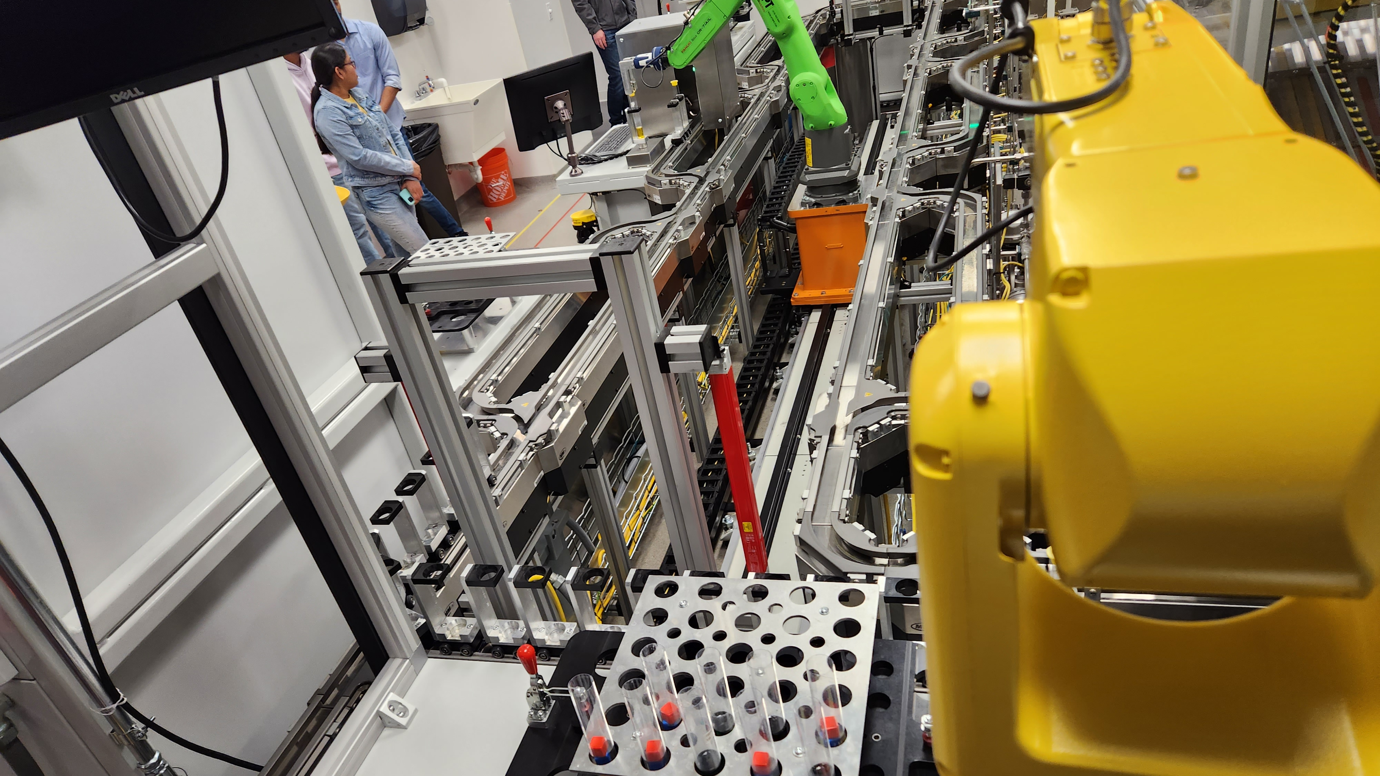
Summary
Notes:
Read during presentation

